Slide 1

G2M insight for Cab Investment firm
Company Name : XYZ Location: USA Team: Data and Analytics Date: 10/10/2021

Slide 2

Agenda
Executive Summary
Problem Statement
Approach
EDA
EDA Summary
Recommendations

Slide 3
Background Information
Our Client: XYZ is a private company based in the United States. Due to its tremendous growth in the Cab Industry in recent years and the presence of multiple key players in the market, it is starting to plan an investment in the Cab Industry, and as part of their Go-to-Market (G2M) strategy, they want to understand the market before deciding.
Objective: XYZ’s Executive team wants to know which company is the best for investment based on our findings, and results from data analysis
Two Cab companies: Yellow and Pink Cab
Data Analysis included:
Data Understanding
Business situation of two cab companies
Finding the best company for investment from three aspects: Travel Frequency, Profit, and Customer Behavior Analysis
Conclusions and Recommendations

Slide 4


Data Exploration
Cab_Data.csv – this file includes details of transaction for 2 cab companies.
Customer_ID.csv – this is a mapping table that contains a unique identifier which links the customer’s demographic details.
Transaction_ID.csv – this is a mapping table that contains transaction to customer mapping and payment mode.
City.csv – this file contains list of US cities, their population and number of cab users.
Cab_data
Customer_ID
City
Transaction
Master Dataset: DF

Slide 5

EXPLORATORY
DATA
ANALYSIS

Slide 6
Questions to understand the market
Which company has more profit?
Which company has more users?
Which company has the most loyal customers?

Slide 7

Distribution of Customers in different cities

Slide 8
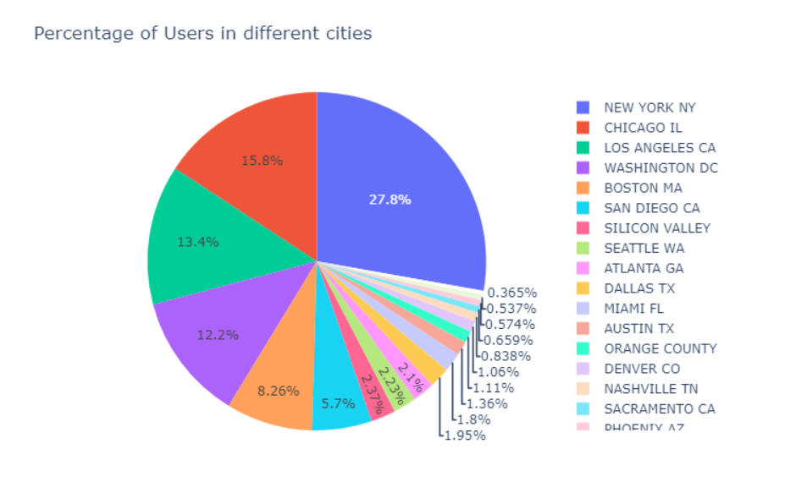
Percentage of Users in different cities
New York City has the highest Cab users with 27.8%.
Chicago, Los Angles and Washington are also contributed to high number of users with 15.8%, 13.4% and 12.2% respectively

Slide 9
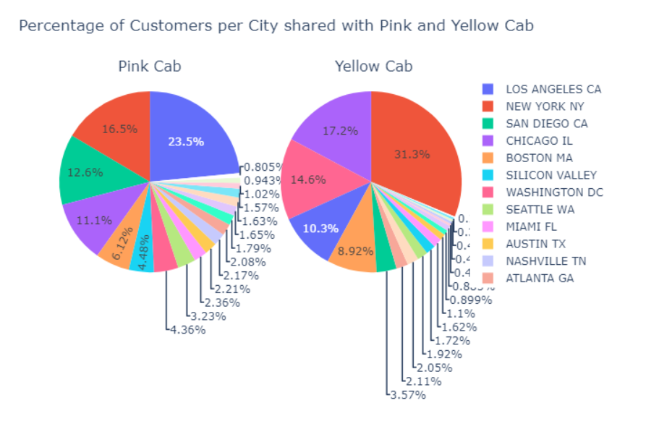
Distribution of Users shared by each Company
New York City is one of popular cities, and one of the valuable cities for both two cab companies. For Yellow Cab, there were 86,000 users (31.3%) over total users compared to 20,000 users (23.5) from Pink Cab
Only the number of customers riding with Pink Cab in Los Angeles followed by San Diego higher than Yellow Cab with 23.5% and 12.6% respectively compared to 10.3% and 3.5%.

Slide 10

Profit

Slide 11
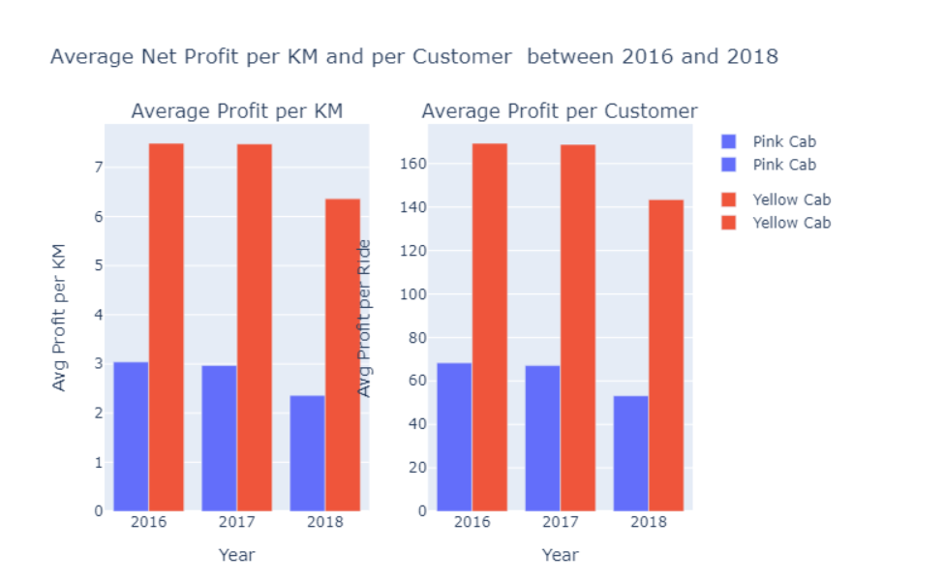
Average Profit per Customer and per KM (Distance)
For Yellow Cab, each KM travel can generate for the company 7.49, 7.48 and 6.36 dollars in 2016, 2017 and 2018 respectively.
In contrast, this number is lower for Pink Cab with 3.04, 2.97 and 2.36 dollar respectively in the same year range.
For each customer riding with Yellow Cab, each customer brought 169.35, 168.82 and 143.42 dollars from 2016 to 2018 respectively whereas this number is 68.32, 67.07 and 53.23 dollars respectively.

Slide 12
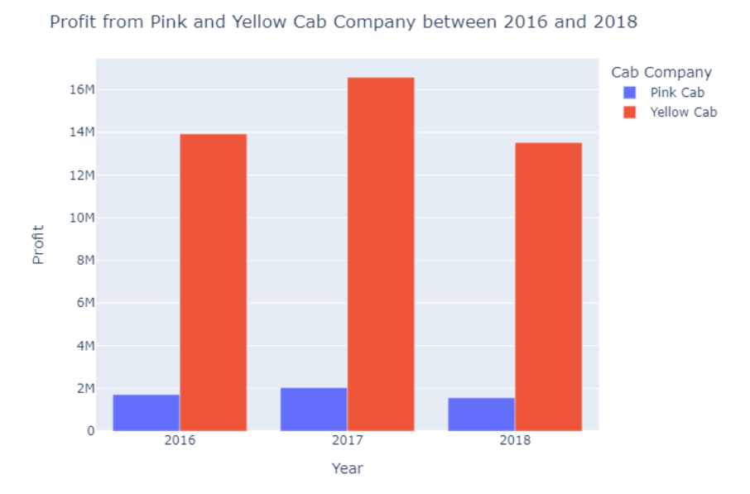
Profit Per Year from 2016-2018
In general, Yellow Cab has higher profit from 2016 to 2018 compared to Pink Cab.
From 2016 to 2017, both Yellow and Pink Cab had been experienced the increase in Profit.
For Yellow Cab, 2016 was the most successful year with roughly 16.57 million dollars compared to nearly 2 million dollars from Pink Cab.
2018 had been experienced the dramatically decrease in profit of both company with the loss up to nearly 3 million dollars.

Slide 13
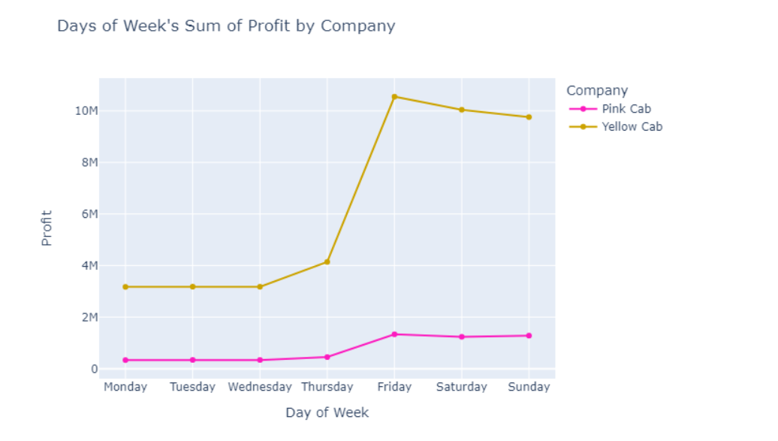
Profit based on Days of the Week
Yellow in general has higher profit compared to Pink Cab in everyday.
For Yellow cab's Profit started to increase from Wednesday day to reach a peak on Friday and decrease slowly to Sunday.
Pink Cab had a stable profit in everyday of a week with the slightly increase from Thursday to Friday.

Slide 14
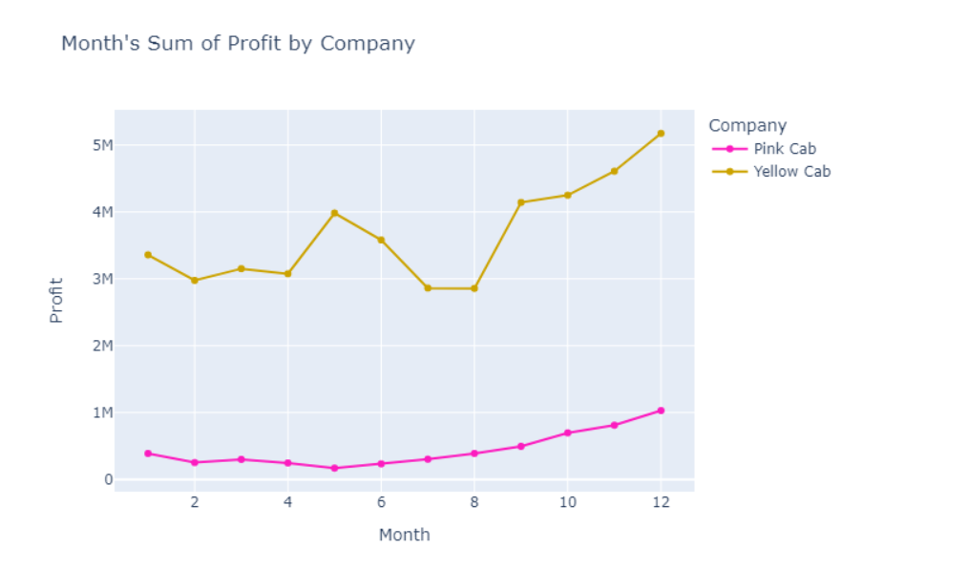
Profit by Month
Yellow in general has higher profit compared to Pink Cab in every month. Profit from both companies starts to increase from August to December.
December is the busiest month, and the most profitable month in the year for both companies.
For Yellow Cab, they can make more than 5 million USD dollar compared to only 1 million USD dollar from Pink Cab.
The profit line from Yellow not stable compared to Pink Cab, where their profit line does not change dramatically.

Slide 15
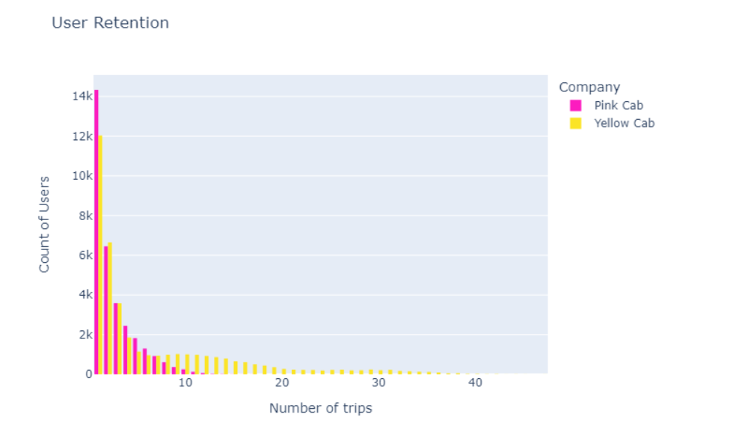
Customer Behavior Analysis
The number of users decrease by increasing the number of trips.
For people riding only first time, Pink Cab is the top choice with more than 14k users for the first-time riding.
Maximum number of customer for both companies for the first time was more than 14k for Pink Cab and nearly 12k for Yellow Cab.
After 7 trips, people tend to ride with Yellow Cab compared to Pink Cab.

Slide 16
Hypothesis Testing
Is there any travel patterns by Month? By Days of the Week? What is the most profitable day and profitable month for two companies?
The larger population in cities, the larger users? Is that correct?
Is there any cities still have potential to expand the cab business
The longer distance, the higher the price charged, is that correct?
Is there any correlation between Profit and Price Charged?
Is gender really matter? Should we pick one gender over another?

Slide 17



Travel Frequency

Slide 18
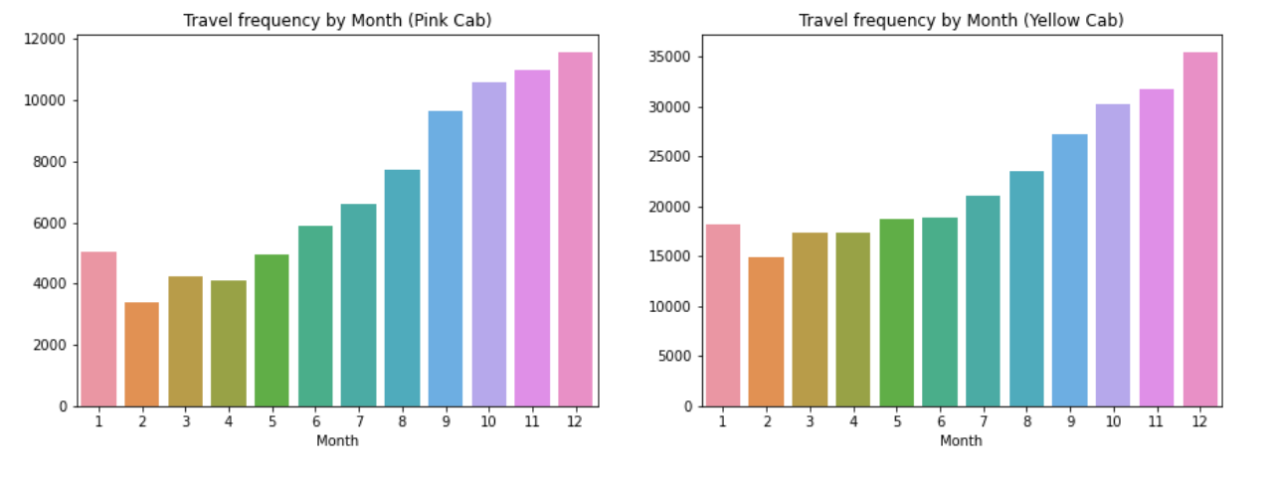
Travel Frequency Pattern by Month
Yellow Cab has higher travel frequency by Month compared to Pink Cab (35000 vs 12000 total)
From Summertime to December, holiday month, both company has been experienced the increasing travel frequency

Slide 19
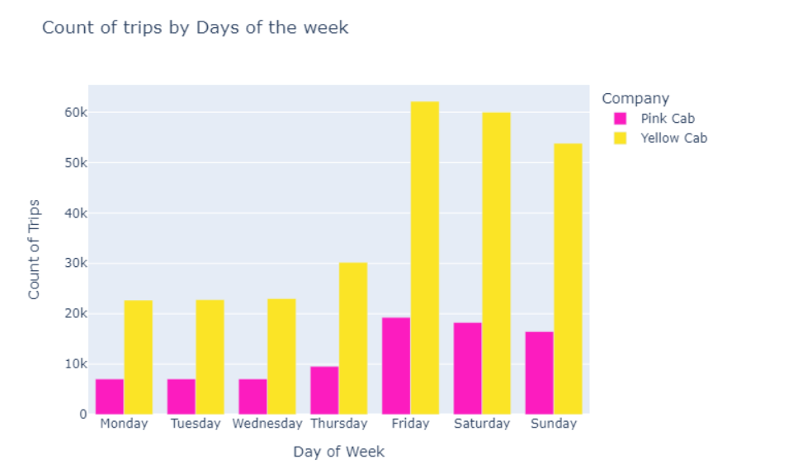
Travel Frequency Pattern by Day of a Week
Yellow Cab is the top choice for customer when riding in day of a week with more than 60000 rides compared to 20000 rides from Pink Cab.
Both companies have the same pattern for day of a week: it start increase dramatically from Thursday to Friday and starts to decrease from Sunday.
Friday is the busiest day in a week for both two cab companies

Slide 20
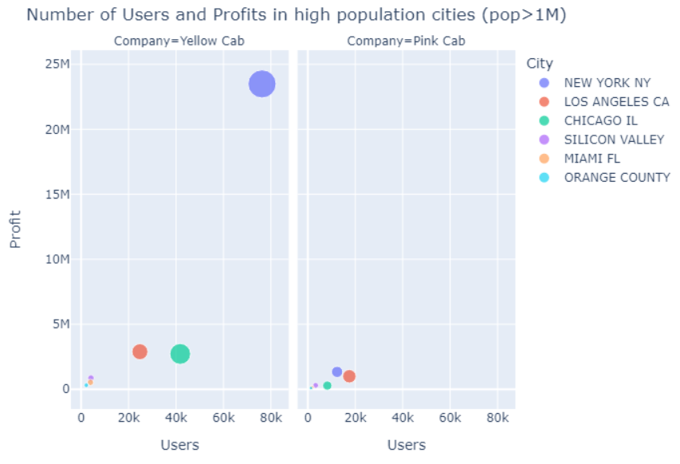
There is still room for an expansion
Silicon Valley, Miami and Orange County are three big area that more than 1 million population, and the customers from these cities have monthly income above $ 5000/ month.
These three cities are among lowest users from both Yellow and Pink Cab. There is still room for two cab companies to expand to these cities

Slide 21
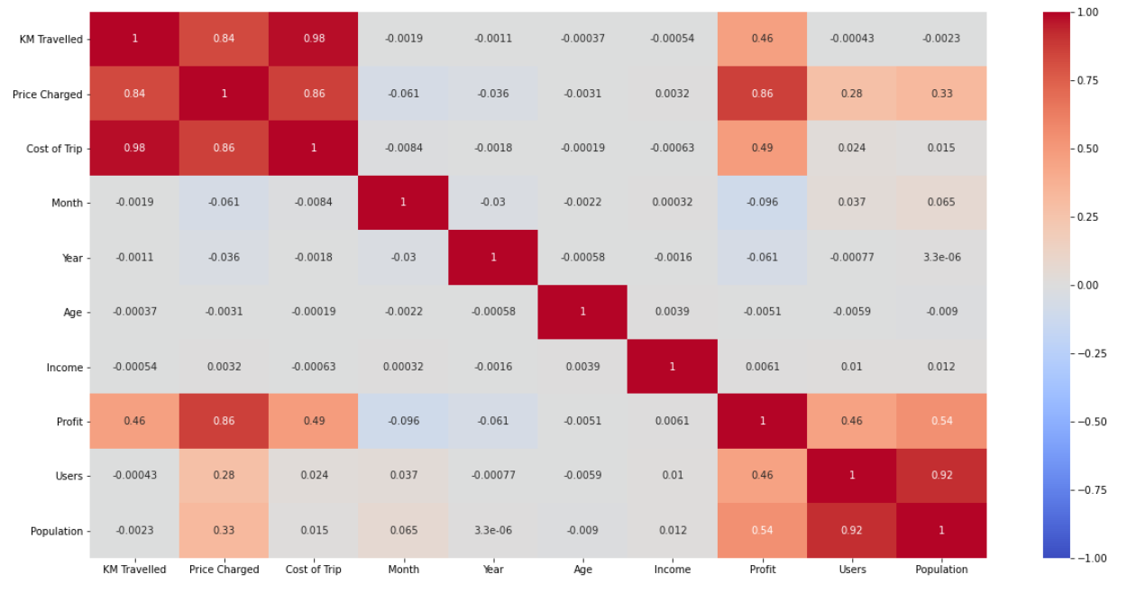
Correlation between variables
There is a correlation between:
Profit & Price Charged around 0.86
Population and Users:0.92 Cost of Trips and KM Travelled: 0.98
Price Charged and KM travelled: 0.84
But is that correct?
Let’s do some tests

Slide 22
Higher Population, Higher Users?
Although there is a strong positive correlation between Population and Users: 0.92, Silicon Valley, Miami and Orange County, with population more than 1 million, still has lower users compared to mid-size cities
Population could be a factor cause the increase in high users, but in these big cities, people tend to ride their own vehicle rather cabs?
Therefore, we cannot conclude that population can lead to higher users

Slide 23
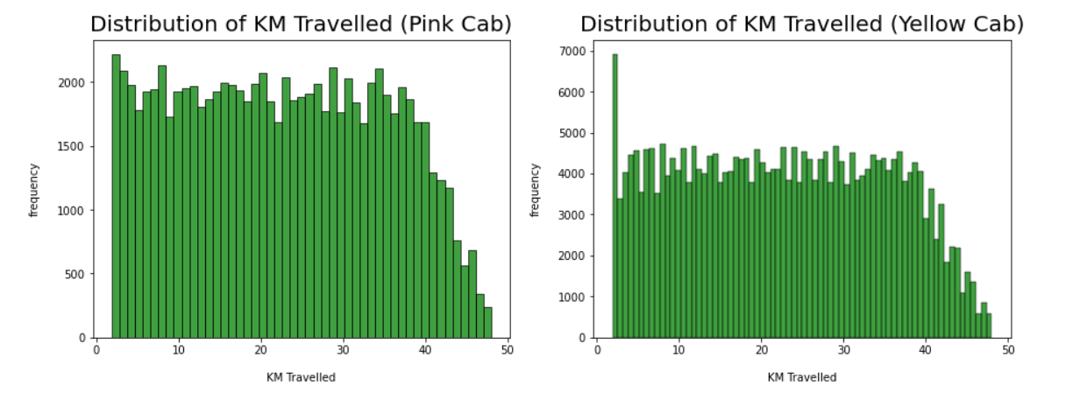
Distribution of distance
Distance is one of important factors, which could impact the price, and most of the rides start from 2KM to 48KM

Slide 24
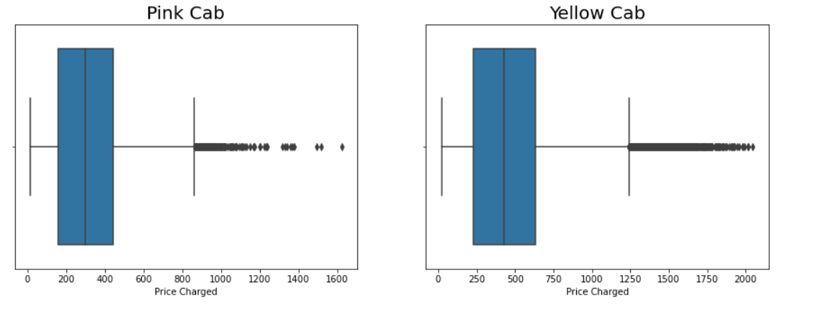
Distribution of Price Charged
Some of the outliers in both graph could be due to special situation such as extreme weathers, rush hours, or high-end cars services

Slide 25
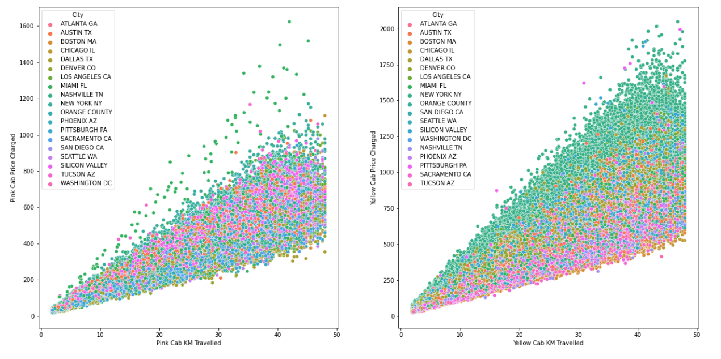
Price Charged vs Distance in different cities
At New York City, the Yellow Cab price charged is more than other cities.
All cities have the same increase in prices with increase in distance when riding with Pink Cab

Slide 26
Results
There is a strong positive correlation between Price Charged and Distance, but we cannot conclude the longer distance, the higher price charged
Distance is one of the important factor, but some outliers suggest that it could be from different factors such as weathers, rush hours, and high-end service. For example, New York is one of the busiest city, and this city is expensive, and always under traffic jam for hours. The longer customers waiting under traffic jam while riding with Yellow Cab could contribute to higher Price Charged.
Therefore, Distance is one of the factor could associate the higher price charged but we will need more data to conclude the causable connection between Distance and Price Charged.
There is a strong positive correlation between Price Charged and Profit, the higher Price Charged, the higher Profit for both Companies. We can conclude that Price Charged is one of the important factor associate to the higher Price Charged compared to other factors such as number of users, counts of trips or population.

Slide 27
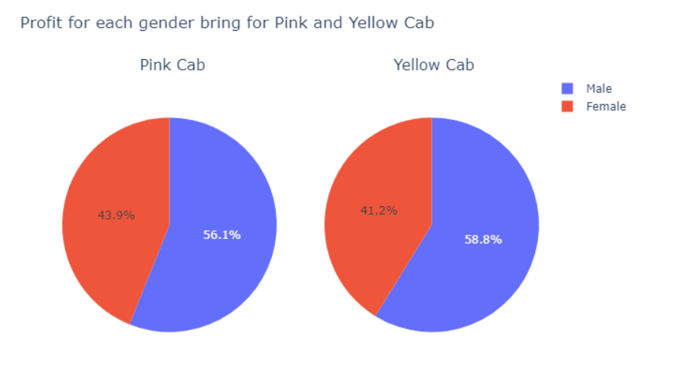
Is gender could affect the Profit in both companies?
Male customer brought more profits for both companies. For Yellow Cab, Male customers brought around 25 million dollars compared to 18 million dollars by women
Pink company also has the same pattern with Male customers accounted more than 50% percentage of profit brought to the company with nearly 3 million dollars compared to 2.3 million dollars with Female Customers.
We need to conduct t-test to find the correlation between gender and profit to decide gender really made an impact to profits for two companies

Slide 28
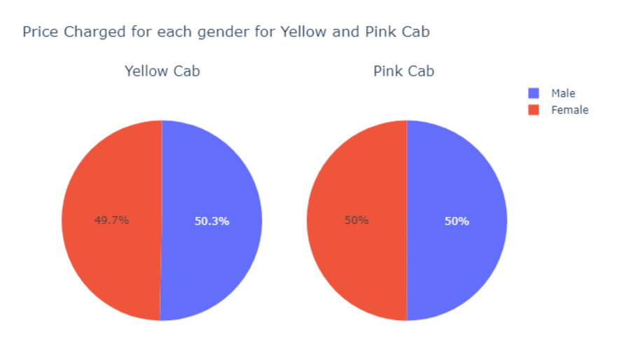
Price Charged in each gender
Female Customers riding with Yellow Cab had been charged less than Male whereas both Male and Female customers riding with Pink Cab had been charged the same.
Although Male Customers tend to pay higher money compared to women in Yellow Cab, but the price charged for both companies does not favor one gender over another.
We will conduct a T-Test to conclude about the gender effects

Slide 29
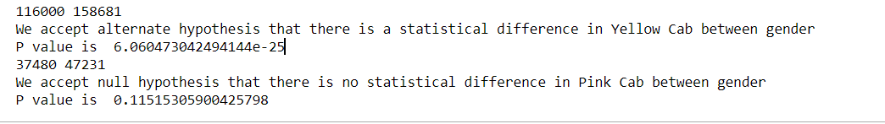
T-Test Result
Yellow Cab: There is difference in Profit between Male and Female customers
Pink Cab: There is no difference in Profit between Male and Female customers
For Yellow Cab, gender could be matter in generating profit. Male Customers tend to brings more profit compared to Pink Cab. Therefore, we can say that for Yellow Cab, Male Customer tend to contribute higher profit compared to women, but it could be some other factors affect
There are no gender different in Profit for Male and Female customers for Pink Cab. The reason it could be because Pink Cab charged the same amount of money regrading its gender.

Slide 30
EDA SUMMARY
Yellow Cab is leading, accounted more than 70% of the profit. Profit of Yellow Cab, although has been decreased in 2018, still higher compared to Pink Cab.
Yellow Cab also the top choice for customers in many big cities, where most of the revenue come from these cities. From other cities, Yellow Cab still represent as bigger competitor compared to Pink Cab
About travel pattern, Yellow Cab always a top choice for riding on weekends, especially a single Friday could bring over $ 10 million for Yellow Cab and over $1.5 million for Pink Cab. In contrast, Pink Cab is the most favorite for customers for their first ride while customers tend to pick yellow cab after 7 trips riding with both cab companies.
Male customer riding with Yellow Cab tend to pay higher compared to women while Pink Cab charged for both genders the same amount of money. In addition, distance could also another reason contribute to higher price charged and other hidden factors to price charged when riding with Yellow Cab due to the outliers in price charged distribution.
Price charged could be top reasons for the higher profit contribution for Yellow Cab compared to Pink Cab
In conclusion, we highly recommend Yellow Cab is the best choice for investment

Slide 31
Thank You

